Slide 1
Mood-based car suggestion

Slide 2
Introduction

Slide 3

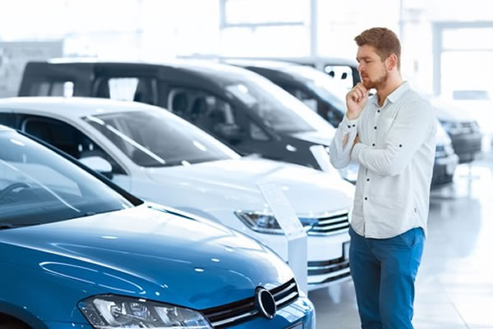
Indecision
“Car buying is driven by many factors, but emotion is undeniably the most influential.”

Slide 4
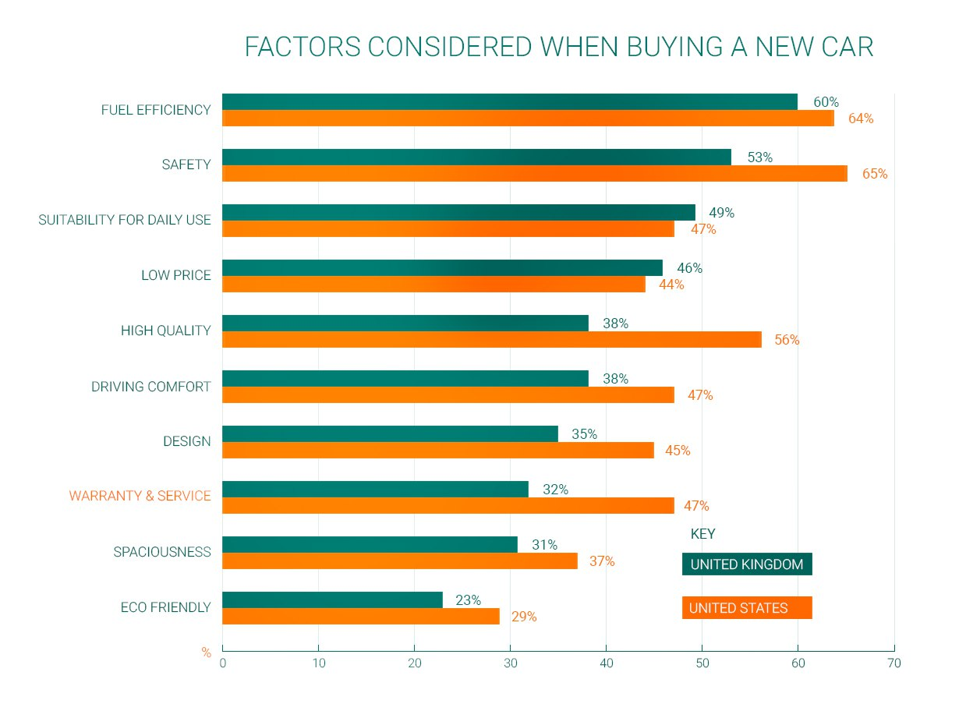
What to consider?
Statista

Slide 5
Market Analysis

Slide 6
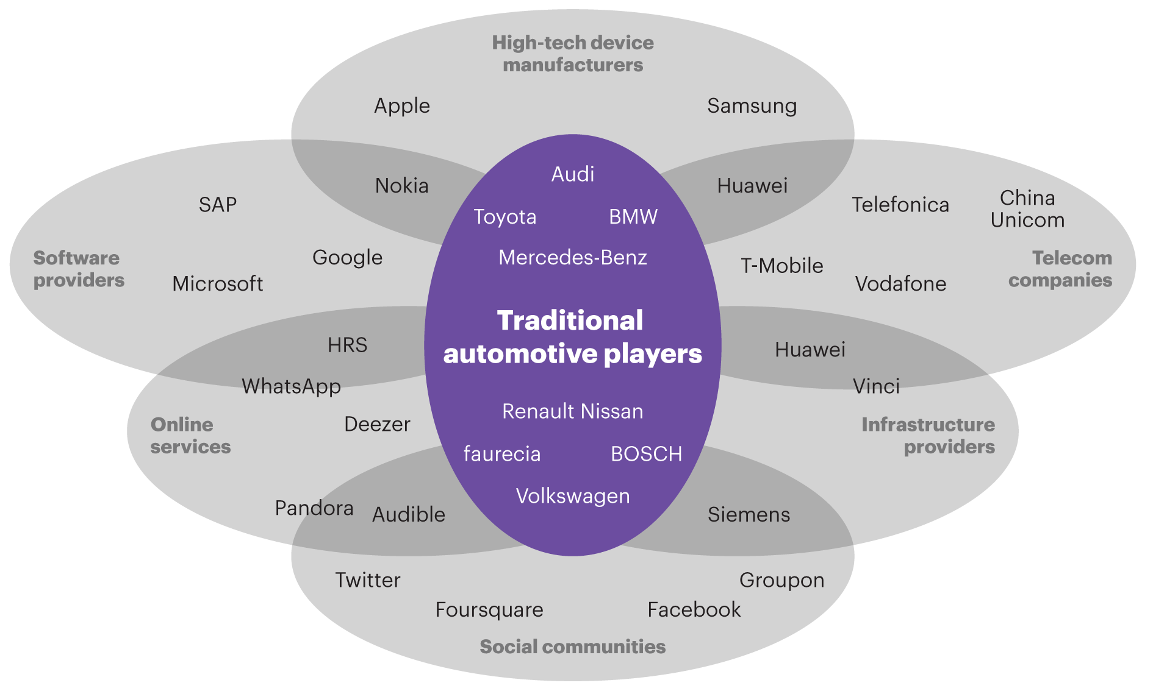
Companies interested in the sector
Globenewswire.com
Notes:
Emotion Detection and Recognition Market is Poised to Reach (globenewswire.com)
CAGR → Tasso composto di crescita annuale

Slide 7
Industries investing in Self-driving Cars
COMPANY | MARKET CAPITALIZATION
Alphabet | $1.5 trillion
Amazon | $1.2 trillion
Tesla | $783 billion
Nvidia | $456 billion
Qualcomm | $156 billion
Micron Technology | $83 billion
General Motors | $55 billion
Ford | $54 billion
Data source: YCharts. Data as of May 17, 2022
Notes:
8 Self-Driving Car Stocks to Consider in 2022 | The Motley Fool

Slide 8
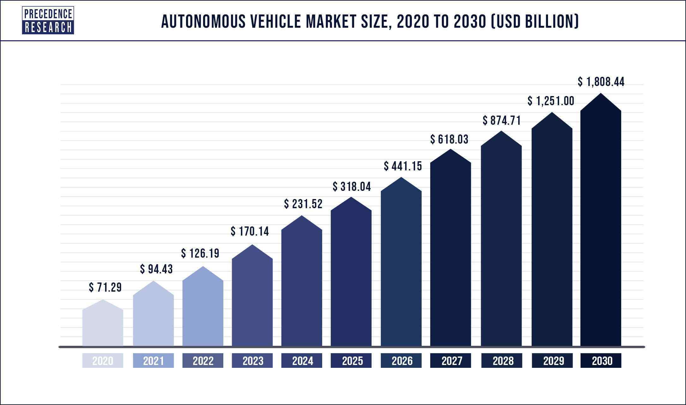
Self-driving Cars
precedenceresearch.com
Notes:
https://www.precedenceresearch.com/autonomous-vehicle-market

Slide 9
Industries investing in Emotion Detection and Recognition
REPORT METRICS | DETAILS
Market Size by 2030 | USD 53.2 Billion
CAGR | 39.20% From 2022 to 2030
Globenewswire.com
Notes:
Emotion Detection and Recognition Market is Poised to Reach (globenewswire.com)
CAGR → Tasso composto di crescita annuale

Slide 10
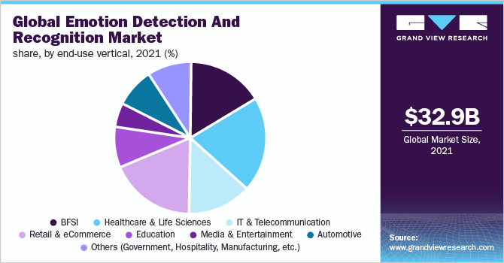
Emotion Detection and Recognition
grandviewresearch.com
Notes:
https://www.google.com/url?sa=i&url=https%3A%2F%2Fwww.grandviewresearch.com%2Findustry-analysis%2Femotion-detection-recognition-market-report&psig=AOvVaw2OrtyCI5tFF_ldDkxLtVKU&ust=1676225037590000&source=images&cd=vfe&ved=0CBAQjRxqFwoTCLDfoYGHjv0CFQAAAAAdAAAAABAWCAGR → Tasso composto di crescita annuale

Slide 11
State of the Art

Slide 12
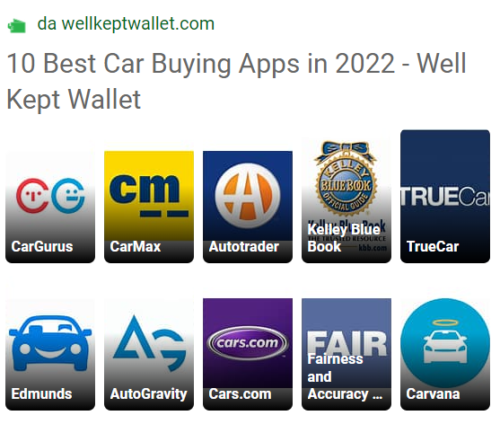
State of the art – what’s in common
Used and new cars
Search filters
Car comparison
Drivers and experts reviews
Rating
Information about dealers
Search saving
Leasing
Notes:
Interessanti KBB (offers the easiest way to compare car values -> used and new cars) e carvana (With an account, you can “favorite” cars for quick comparison and get an estimate for your trade-in -> used cars -> 1 mln download), TrueCar (new or used selling or trading)

Slide 13




State of the art – most used
(used and new)
(used)
(new and used)
Details on car history
Free reports and repair and maintenance service
Augmented reality and evaluation of market value
Notes:
Interessanti KBB (offers the easiest way to compare car values -> used and new cars) e carvana (With an account, you can “favorite” cars for quick comparison and get an estimate for your trade-in -> used cars -> 1 mln download), TrueCar (new or used selling or trading)
Sono le più scaricate con le caratteristiche in più rispetto alle altre

Slide 14
State of the art - What is missing?
No consideration of emotions:
Coca Cola, Disney
New York Times, USA Today, Daily Beast
Hyundai Motor’s Mini ‘45’ EVO
No real time suggestion:
Amazon Personalize
Alibaba Cloud
No customer history regard:
MAC Cosmetics
No interactive experience:
Momentum Worldwide, WE KNOW Experience 2.0
Fung Business Intelligence Centre
Crossmark, Path to Purchase Institute, Marketing Werks
Notes:
Market Research: In the film industry to get a greater insight into what provokes an emotion
Digital Advertising: Help to recommend products that will satisfy the customers’ requirements and expectations
Hyundai Motor’s Mini ‘45’ EVO
"Con Amazon Personalize, siamo riusciti a suggerire contenuti in modo più accurato ai nostri clienti, e le prime analisi indicano un aumento del 6% nei minuti medi visualizzati per raccomandazione e una riduzione del 15% della frequenza di rimbalzo rispetto al nostro sistema legacy". Alex Tverdohleb, vicepresidente di Data ServicesFOX
"Grazie ad Amazon Personalize abbiamo registrato un aumento di 5 volte in risposta ai prodotti consigliati rispetto alla nostra precedente soluzione di analisi di Big Data con conseguente aumento delle entrate mensili. In particolare, Amazon Personalize ha aumentato fino al 40% il numero di prodotti che i clienti non avevano mai acquistato prima.« Jaehyun Shin, Big Data Team Leader Lotte Mart
“Speech recognition will enable [Alibaba] to tell [us what] our customer’s emotions are like, and how angry [they are]. Then our customer service will be able to react to the customers accordingly, with the help of data derived from speech recognition,” Wanli Min, chief Scientist for Artificial Intelligence in Alibaba Cloud said in Cloud Computing Conference held in Shenzhen on Wednesday.
No customer history regard:
MAC Cosmetics (2.2% uplift per costumer)
No interactive experience: https://www.shopify.com/ca/retail/experiential-retail
Momentum study shows that 76% of shoppers would rather spend money on experiences than products
Fung showed that 78% of the surveyed key department store operators in China have added experiential elements in their stores
https://www.crossmark.com/wp-content/uploads/14P2P_CrossmarkWhitePaper_LoRes.pdf

Slide 15
State of the art – until now
Hyundai Motor’s Mini ‘45’ EV
Emotion detection
Changes of lights, scents and music basing on emotions
Renault SYMBIOZ demo car
Immersive experience with fragrances, ambient lights, video and music
Tesla Model 3 and Model Y
Facial recognition to retrieve user profile

Slide 16
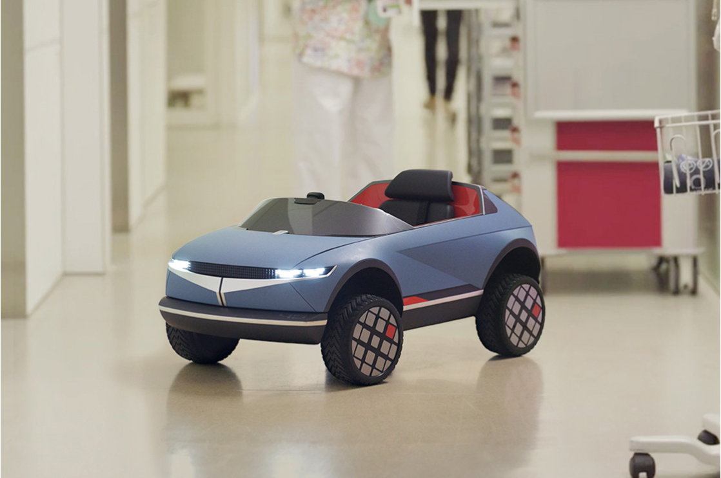
Hyundai Motor’s Mini ‘45’ EV
AI-based technology optimizes vehicle environment based on driver’s mood
Detects emotion, breath and heart rate
Actively controls vehicle systems such as lighting, climate, music and fragrance dispenser
Notes:
Market Research: In the film industry to get a greater insight into what provokes an emotion
Digital Advertising: Help to recommend products that will satisfy the customers’ requirements and expectations
One-on-one Interviews: Find the person best suited to the job disposing of prolonged hiring processes.

Slide 17
Tesla and Kia
Tesla Model 3 and Model Y (65,000 $ to 80,000 $)
Facial recognition and advanced driver assistance for:
Ensure driver is seated
Ensure driver is paying attention
Driver and passenger profile
Sold until now 50,000 Tesla Y and 300,000 Tesla 3
Kia K9 (51,000 $ to 68,000 $)
Fingerprint biometric authentication system to:
select between multiple personalized profiles
Alter seat position
Climate control settings
Side mirror position
Authenticate payment
Sold about 2500 a year
Notes:
Market Research: In the film industry to get a greater insight into what provokes an emotion
Digital Advertising: Help to recommend products that will satisfy the customers’ requirements and expectations
One-on-one Interviews: Find the person best suited to the job disposing of prolonged hiring processes.

Slide 18
Chinese automakers
Foxconn with Stellantis
Vehicle cockpit with:
biometric authentication
remote commands
augmented reality
Lotus and Volvo
Mercedes-Benz EQS (115000$)
Fingerprint scanner and face biometrics camera to:
Provide authentication
Alter seat position
Fatigue monitoring
Side mirror position
Sold more than 2000 units in 2021
Notes:
Market Research: In the film industry to get a greater insight into what provokes an emotion
Digital Advertising: Help to recommend products that will satisfy the customers’ requirements and expectations
One-on-one Interviews: Find the person best suited to the job disposing of prolonged hiring processes.

Slide 19
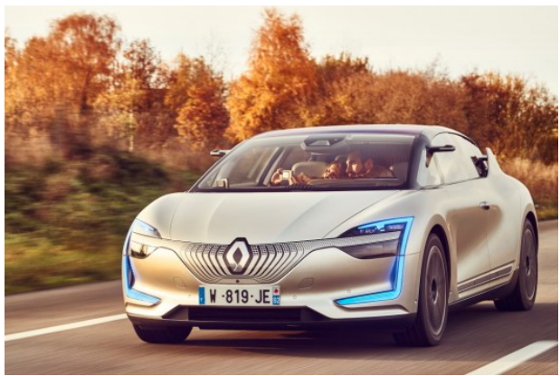
Renault SYMBIOZ demo car (2023)
HMI Concept for Autonomous Car
Continuity between your home and your
At home:
prepare your journey;
check the autonomy of the car, the traffic jam;
choose the points of interest during your trip, music and/or video playlists
When you are ready, call the car that pick up you in front of house’s door!
On board: enjoy your safe trip, no stress, immersive experience with fragrances, ambient lights, video and music.
For a perfect immersion, HMI experience is reinforced with displays and controls systems
Notes:
Market Research: In the film industry to get a greater insight into what provokes an emotion
Digital Advertising: Help to recommend products that will satisfy the customers’ requirements and expectations
One-on-one Interviews: Find the person best suited to the job disposing of prolonged hiring processes.

Slide 20
What do buyers really want?
The company's annual Future Attribute Demand Study surveyed nearly 90,000 recent car buyers, with over 50,000 of them planning on buying another new car in the future.
About 100 different choices the top 10 features people want are:
Heated seats: 66%
Blind-spot monitoring: 60%
Front and rear parking sensors: 55%
All-wheel or four-wheel drive: 54%
Lane-departure warning: 54%
Apple CarPlay and/or Android Auto: 53%
Power front passenger seat: 52%
LED accent lights: 52%
Ventilated or cooled seats: 50%
Memory driver's seat: 49%
www.autoblog.com
Notes:
The Car is the Top Audio Listening Location - Edison Research

Slide 21
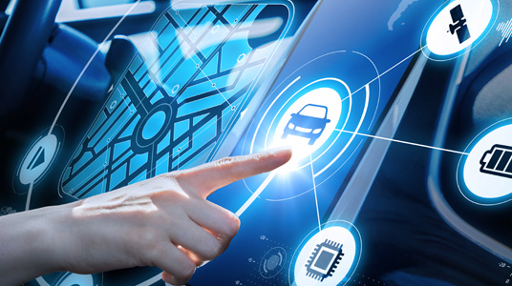
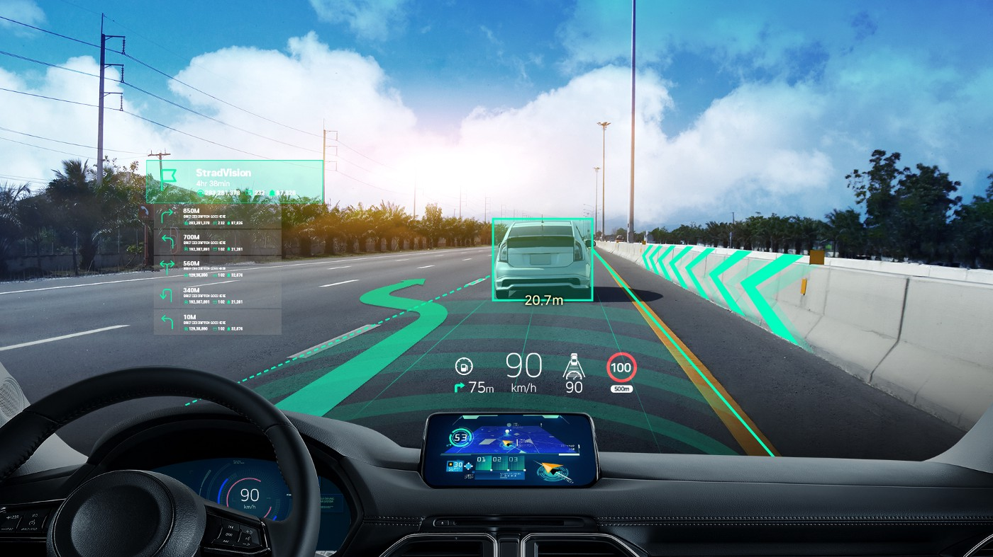
User history
Previous purchases
Past reviews
Experience filters
Driving preferences
Previous guide experiences
Services preferences

Slide 22
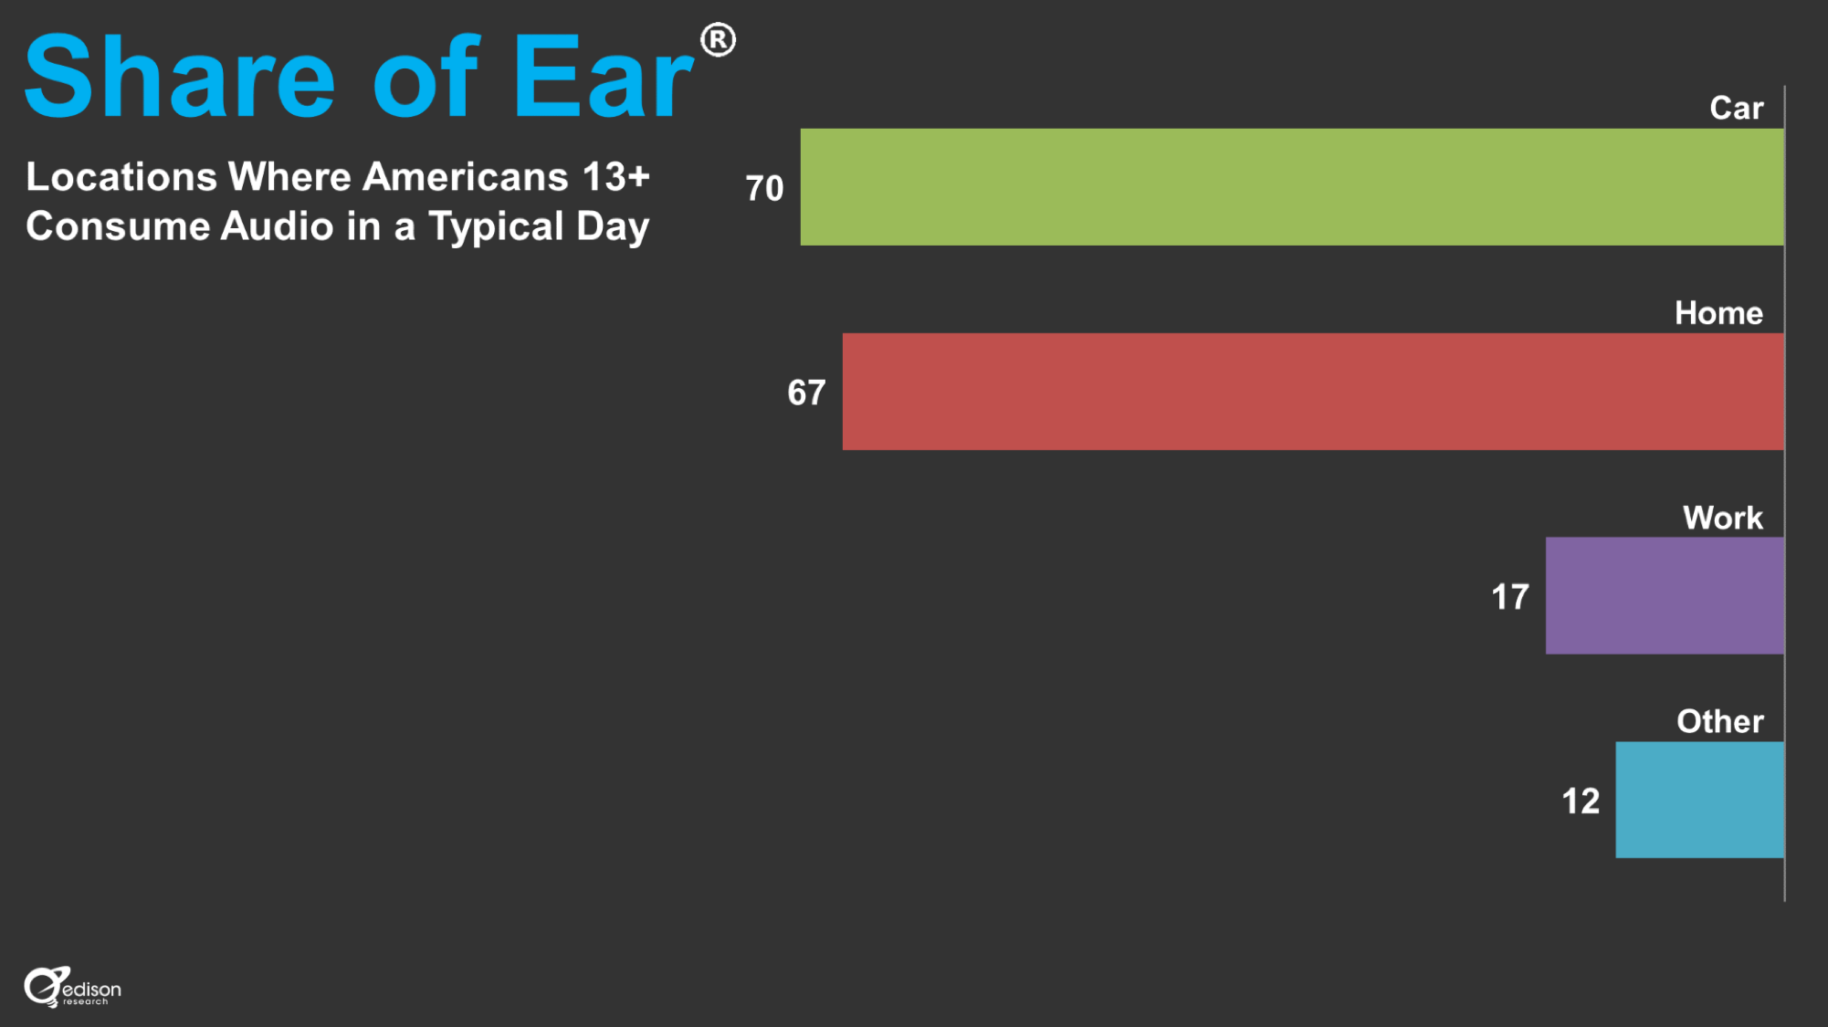
The Car is the Top Listening Location
Notes:
The Car is the Top Audio Listening Location - Edison Research

Slide 23
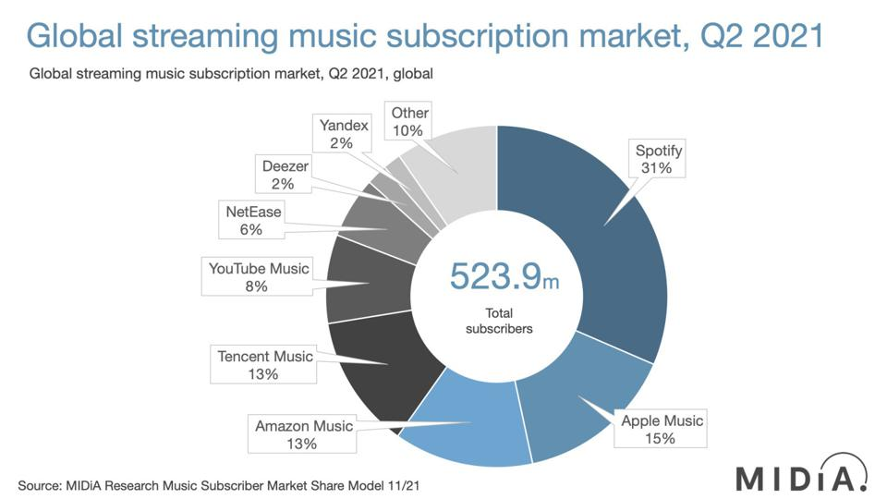
Music: Spotify
Notes:
Research company MIDiA reports that there were 523.9 million paying subscribers on music streaming services globally in the second quarter of 2021, an increase of 26.4% from the same period in 2020. Spotify is still the market leader by some distance, it says, despite rival services eating into its market share.
Spotify, according to its numbers, controls just under a third (31%) of the global market, more than double that of Apple AAPL +0.4% Music (15%), its nearest rival. Indeed, Spotify has a bigger share of the market than Apple Music and Amazon Music AMZN -0.7% (in third place with a 13% share) combined.

Slide 24
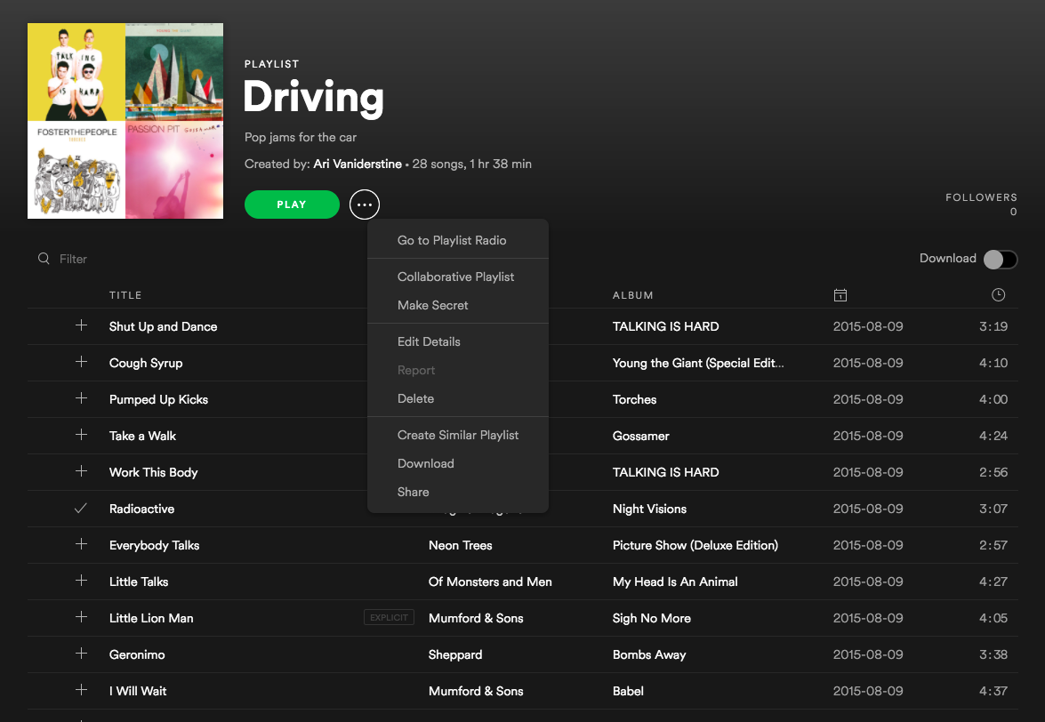
Music: Spotify
Notes:
Personal playlists

Slide 25
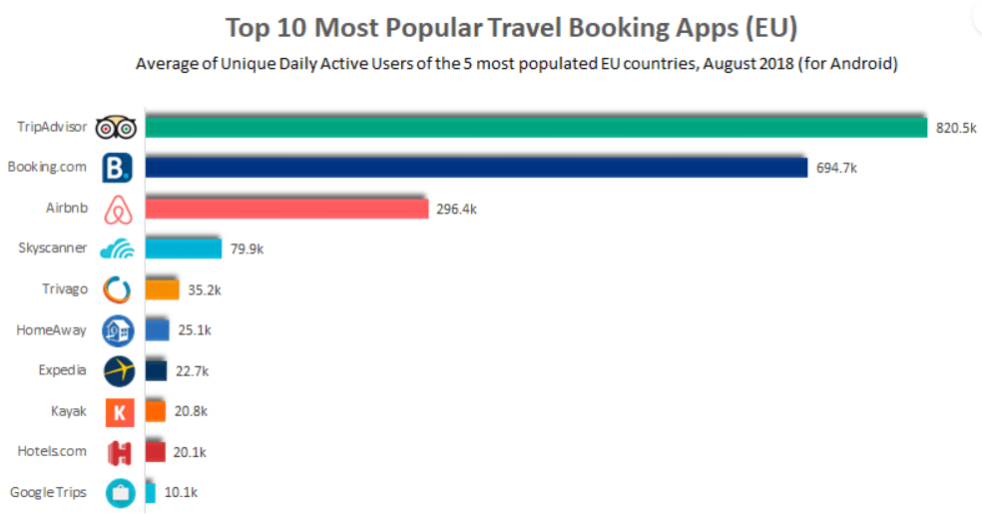
Places: Booking.com
TripAdvisor and Booking.com receive 60% of the visits
www.geckoroutes.com
Notes:
Personal playlists

Slide 26
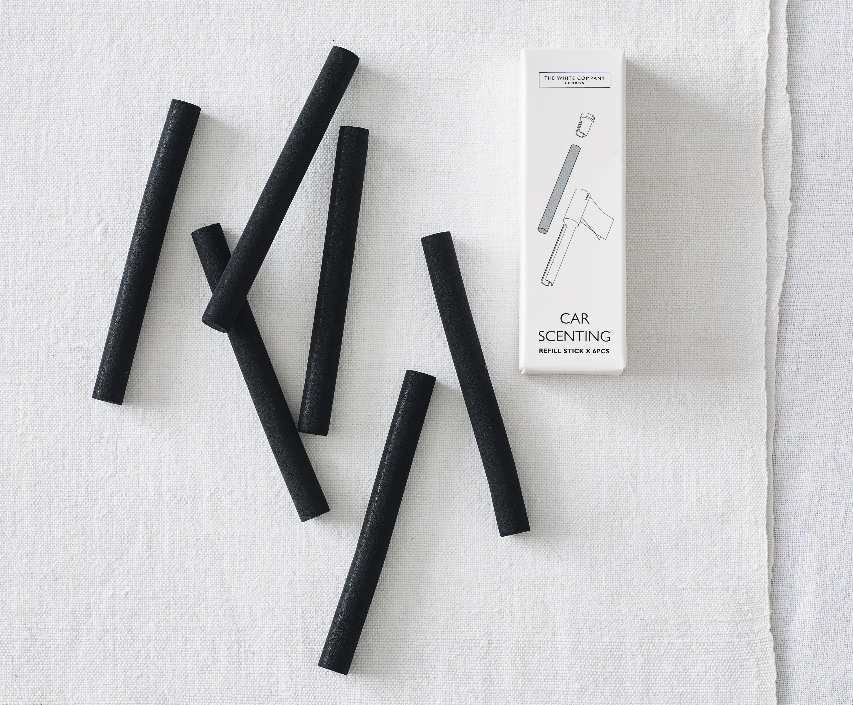
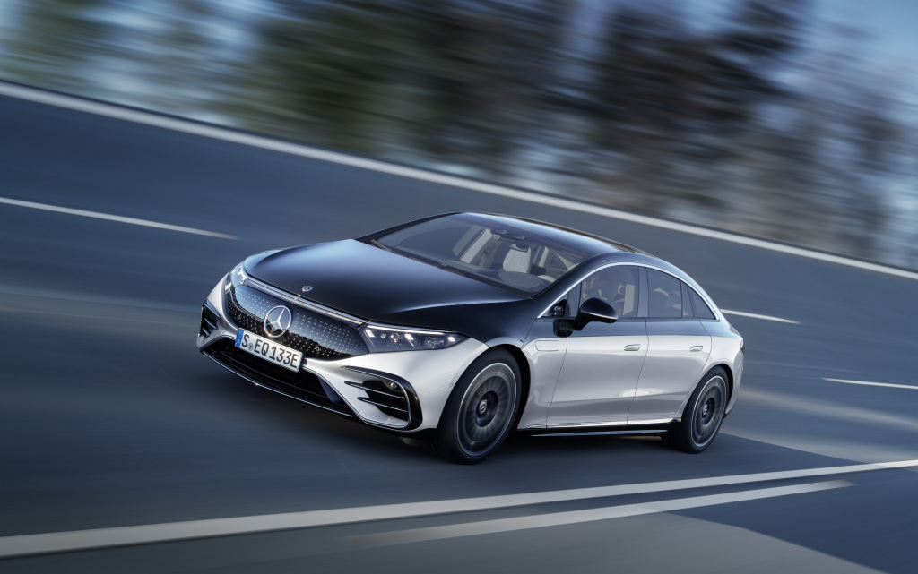
Scents: the case of Mercedez
"When you enter the car, you’ll be greeted by the subtle aroma of a fig tree in the breeze"
"You can have multiple different ones plugged into various vents at once to combine scents"
The new Mercedes EQS
www.readersdigest.co.uk
Notes:
Personal playlists

Slide 27
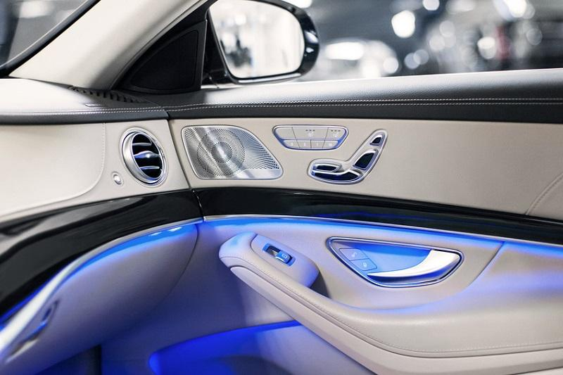
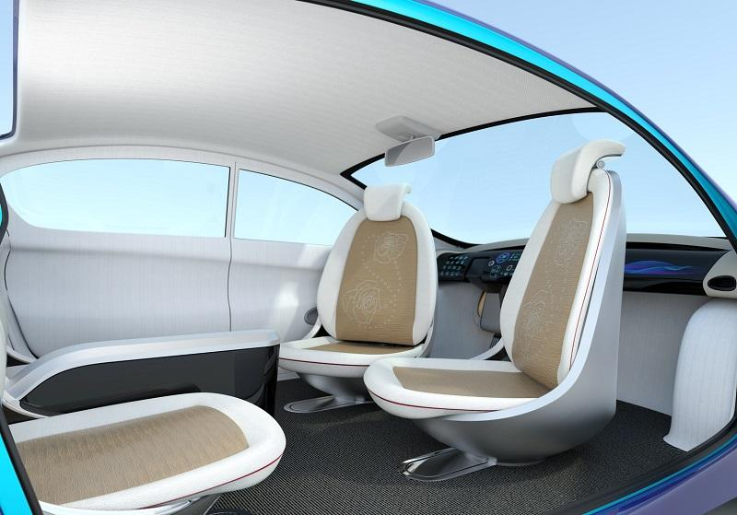
Lights: University of Technology of Munich
"interior auto lighting can influence driver emotions and fatigue"
" The interior experience is main focus in autonomous vehicles, setting the mood for all occupants, depending on whether they want to relax, sleep, or enjoy their infotainment choices."
The new Volvo 360c
Notes:
https://www.automotive-iq.com/car-body-and-materials/articles/the-changing-mood-in-auto-internal-lighting

Slide 28
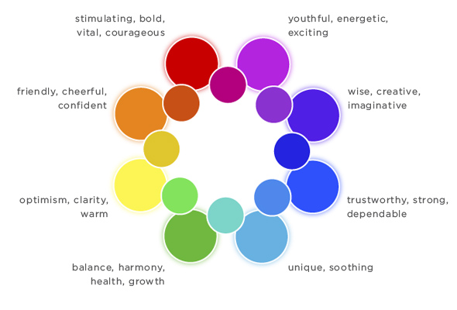
Lights changing with emotions
Notes:
Personal playlists
Importance of lights : https://www.automotive-iq.com/car-body-and-materials/articles/the-changing-mood-in-auto-internal-lighting
Importance of music: https://knaufautomotive.com/importance-of-soundproofing-the-car-interior/
Importance of scents : https://global.nissanstories.com/en/releases/the-science-of-scent

Slide 29
Enabling Technologies

Slide 30
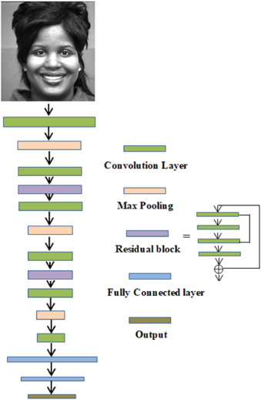
Emotion recognition
Classes: 6 classes corresponding to different emotions
Accuracy: 93% for happy, surprise, neutral
Images resolution: 640 × 480 / 30 fps
Notes:
https://www.sciencedirect.com/science/article/pii/S016786551930008X?casa_token=KOzFGH7sea4AAAAA:1AxQhQUNolggJwaXiy1CxWbm_2_059BfKfrHuF-Z6Ij0OoM1vtEdriot7LtrD_I9JRNYbO-RUg

Slide 31
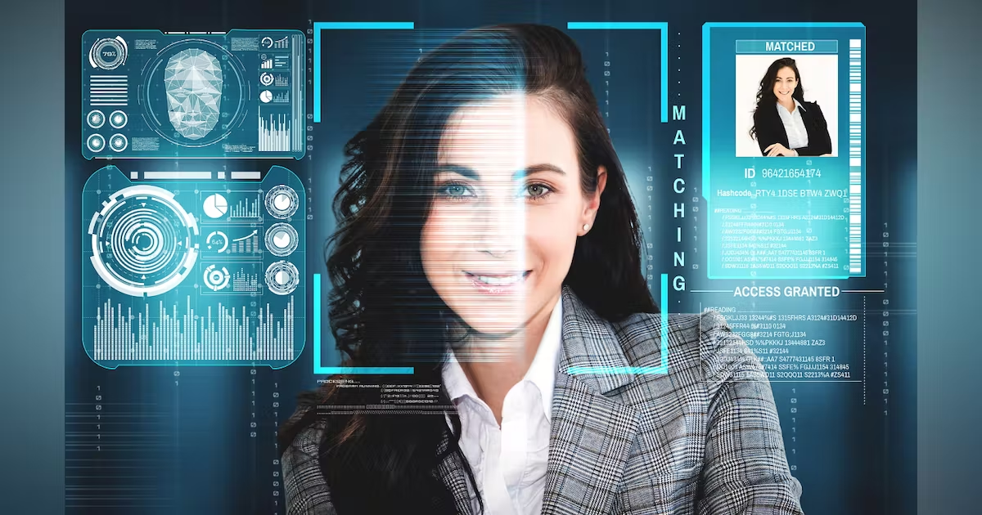
Face recognition
Easy access on user profile
No need to remember username or password
FaceNet provides a 98% accuracy with different datasets
Notes:
https://www.sciencedirect.com/science/article/pii/S016786551930008X?casa_token=KOzFGH7sea4AAAAA:1AxQhQUNolggJwaXiy1CxWbm_2_059BfKfrHuF-Z6Ij0OoM1vtEdriot7LtrD_I9JRNYbO-RUg

Slide 32
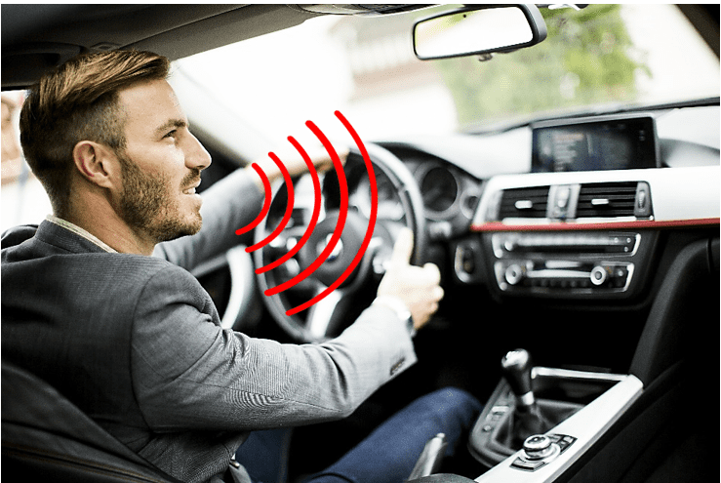
Omnidirectional microphones
Frequency response: 16khz
Snr : 65 dB
Bit rate: 24 bit
Open Circuit Sensitivity: –46 dB

Slide 33
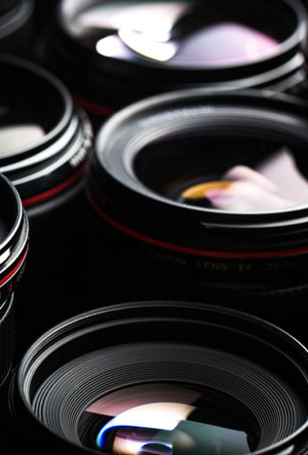
Camera
Price ranges: 55-70 €
Dimensions: 3.4” x 2.4” x 1.1” (63.2 x 88.0 x 28.5mm)
Interior-Facing Camera: Night Vision Infrared, 720p HD video @ 30 FPS, FOV 120 degrees
Power Requirements: DC Power DC 12V Power Source, Sleep Mode after 72 hours
Connectivity: Bluetooth Low Power 4.2
Frame rate: 30fps

Slide 34
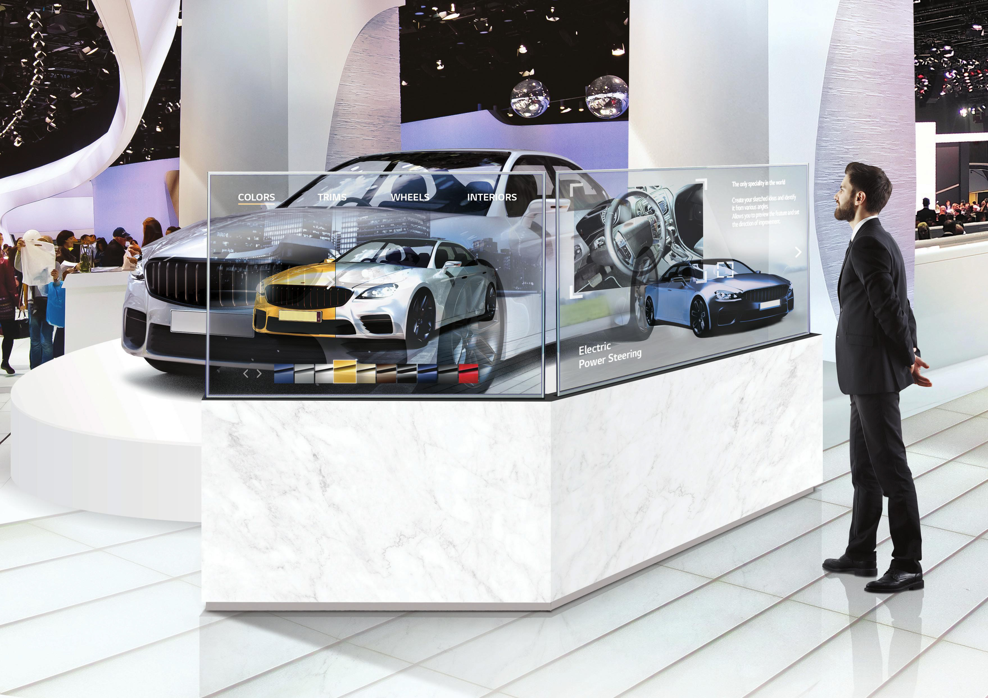
Display
Native resolution: 1920×1080 (FHD)
Vision angle (O x V): 178 × 178
Colour depth: 1,07 billion of colours
Usage time (hours/days): 18/7
Protective screen: 3.0 mm, tempered, no-reverb
Functional temperature interval: -10°C to 50°C
Functional humidity interval: 10% to 90%

Slide 35
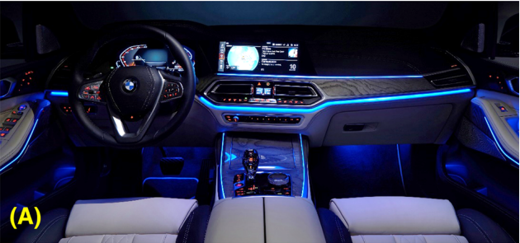
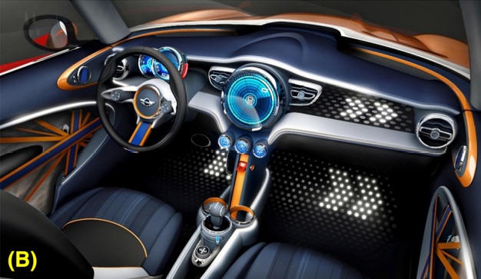
Lights
The upcoming next big trend in automotive interior lighting are 1,000 of RGB light-emitting diodes (LEDs).
Single edge-lit RGB LED
Data rate: 20 kbit/s
Large number of direct-lit RGB LED
Sources: BMW Group, MINI
Notes:
Advances in automotive interior lighting concerning new LED approach and optical performance (researchgate.net)

Slide 36

Lights
Large area “pixelated” lighting with daylight performance requires an optimized combination of optic technologies as well as dedicated electronics, hardware and software:
High power RGB LEDs (daylight readable)
Light guides for direct-lit backlight
Efficient current drivers with high-speed digital interfaces (in the range of Mbit/s)
Dedicated control units capable of addressing hundreds of RGB LEDs in real time with high frame rates (>400 Hz)
Software for designers to create efficiently the content to be displayed
Notes:
Advances in automotive interior lighting concerning new LED approach and optical performance (researchgate.net)

Slide 37
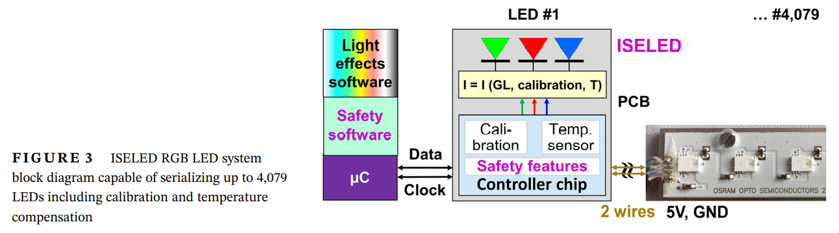
Lights
– calibration and temperature compensation
rate of 2 Mbit/s
Notes:
Il concetto ISELED offre una soluzione elegante per questi problemi. Si basa su un chip controller sviluppato da Inova Semiconductors, che è integrato insieme ai LED RGB in un sistema in pacchetto (SIP), vedi Figura 3. Questi pacchetti possono essere facilmente collegati ad una lunga catena a margherita (due maglie), che è controllato tramite il personalizzato e proprietario Protocollo ISELED.
Circa 200 ISLED possono essere serializzati con un frame rate di circa 80 Hz e tutti i dati del livello di grigio RGB vengono aggiornati ogni frame per le animazioni dinamiche.

Slide 38
Lights – costs
Until now:
to individually control each individual RGB LED
necessity to use a microcontroller containing the specific data of the respective LEDs.
Now:
A single microcontroller can handle a LED strip containing up to 4,096 LEDs.
Lower costs
Simplified control
Expanded functionalities
Notes:
Il concetto ISELED offre una soluzione elegante per questi problemi. Si basa su un chip controller sviluppato da Inova Semiconductors, che è integrato insieme ai LED RGB in un sistema in pacchetto (SIP), vedi Figura 3. Questi pacchetti possono essere facilmente collegati ad una lunga catena a margherita (due maglie), che è controllato tramite il personalizzato e proprietario Protocollo ISELED.
Circa 200 ISLED possono essere serializzati con un frame rate di circa 80 Hz e tutti i dati del livello di grigio RGB vengono aggiornati ogni frame per le animazioni dinamiche.

Slide 39
Scents - diffusers
The White Company’s car diffusers (£15) come as a plug-in stick; just add a few drops of essential oil into the aluminium casing.
Jo Malone now offers car diffuser sets (£73) featuring signature scents like Lime, Basil & Mandarin
Diptyque’s intoxicating Baies (£79) scented cartridge slots into a metal, grille-like diffuser you plug into the air vent.
Acqua di Parma’s diffuser (£95) is made with Poltrona Frau leather; it’s a car diffuser and a design object in its own right.
L’Original London’s orb-shaped diffusers (£39.90), in an array of metallic finishes like rose gold and galaxy silver, double up as fiddle objects you can throw in a handbag and sniff when you’re out and about.
www.readersdigest.co.uk
Notes:
Personal playlists

Slide 40
Requirements

Slide 41

Functional requirements
Acquire user profile
Retrieve user preferences
Detect emotions during drive test and simulations
Compare the results of the different cars
Suggest the best car
Notes:
Viene costruito un profilo in maniera automatica in base a guide precedenti e altri profili e poi può essere modificato a mano prima durante l'acquisizione
Dopo "acquire user profile" avremo fase "check parameters"

Slide 42
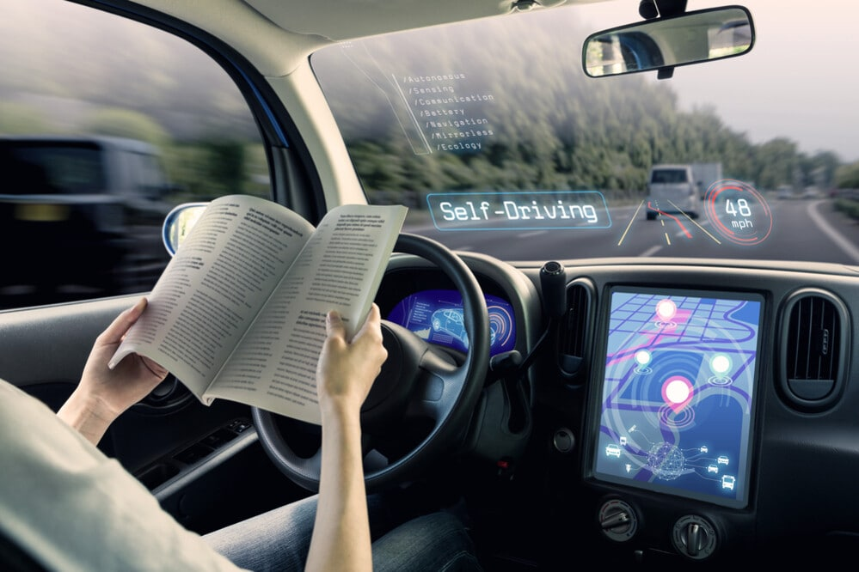
Functional requirements
Acquire user profile
Adapt the experience
Detect emotions during drive test and simulations
Compare the results of the different cars
Suggestion of the best car
Notes:
Dipende dall funzionalità della macchina

Slide 43
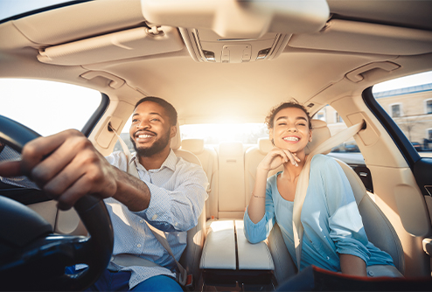
Functional requirements
Acquire user profile
Adapt the experience
Detect emotions during drive test and simulations
Compare the results of the different cars
Suggestion of the best car

Slide 44
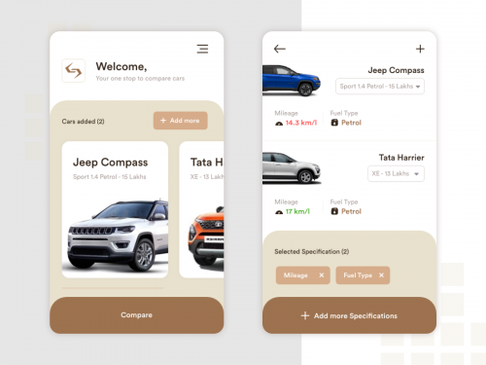
Functional requirements
Acquire user profile
Adapt the experience
Detect emotions during drive test and simulations
Compare the results of the different cars
Suggestion of the best car

Slide 45
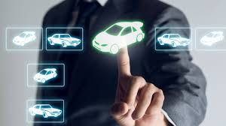
Functional requirements
Acquire user profile
Adapt the experience
Detect emotions during drive test and simulations
Compare the results of the different cars
Suggestion of the best car

Slide 46
Non-functional requirements
Reliability
Accessibility
Performance
Privacy

Slide 47
Non-functional requirements
Reliability
Accessibility
Performance
Privacy

Slide 48
Non-functional requirements
Reliability
Accessibility
Performance
Privacy

Slide 49
Non-functional requirements
Reliability
Accessibility
Performance
Privacy

Slide 50
Non-functional requirements
Extensibility
Platform compatibility
Accessibility
Integrability
Response time
Privacy

Slide 51
Architecture

Slide 52
Stack
Infotainment platform
Device management, IoT, Cloud
Connectivity
User interface/user experience/human-machine interface
Applications
Emotion recognition/Keyword recognition
Operating System
Electric/electronic hardware
Sensors
Actuators
Power components
Vehicle

Slide 53
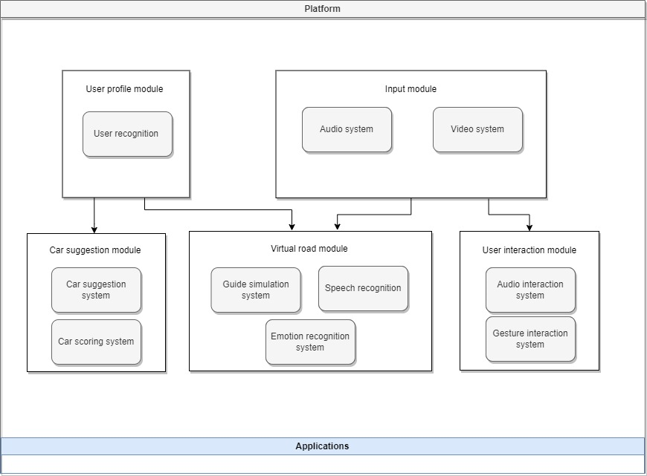
Architecture

Slide 54
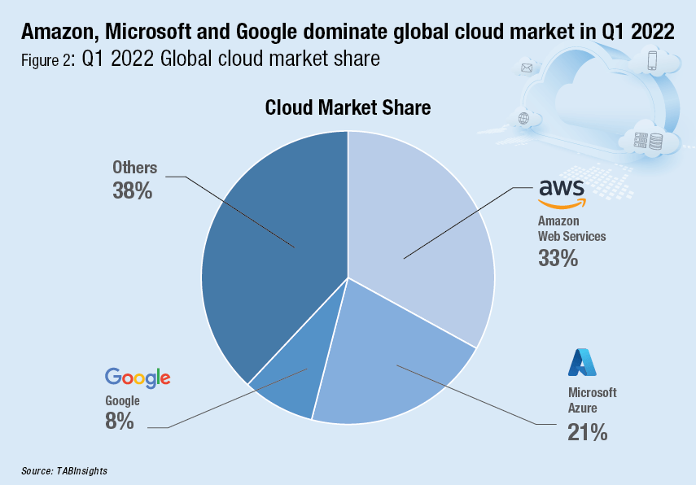
Cloud services - market

Slide 55
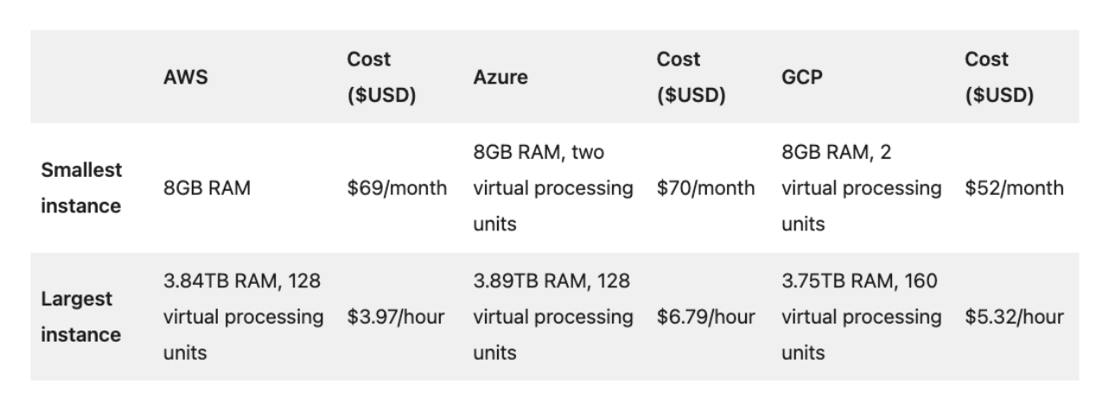
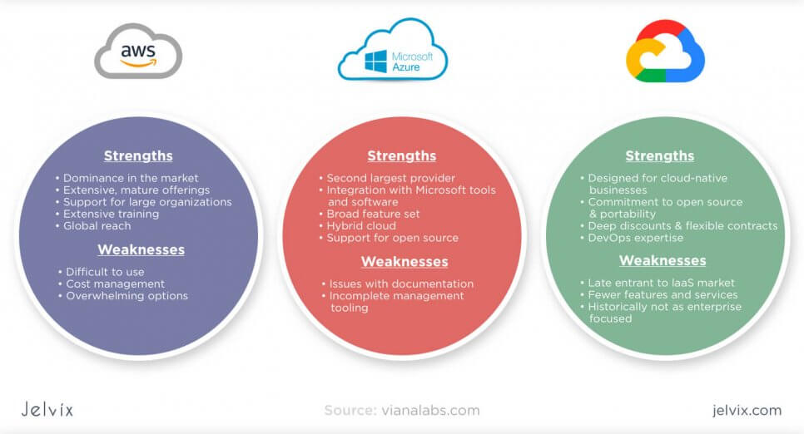
Cloud services – cost compare
AWS needs expensive tools and is more complex, may need third part software
Azure is the most used with sensors and real-time data
Azure is more versatile, instead AWS is more robust
Azure offers hybrid database versions
Notes:
https://www.projectpro.io/article/aws-vs-azure-who-is-the-big-winner-in-the-cloud-war/401
https://sam-solutions.us/aws-vs-azure-v-s-google-cloud-which-is-better/
https://jelvix.com/blog/aws-vs-google-cloud-vs-azure

Slide 56
Project planning

Slide 57
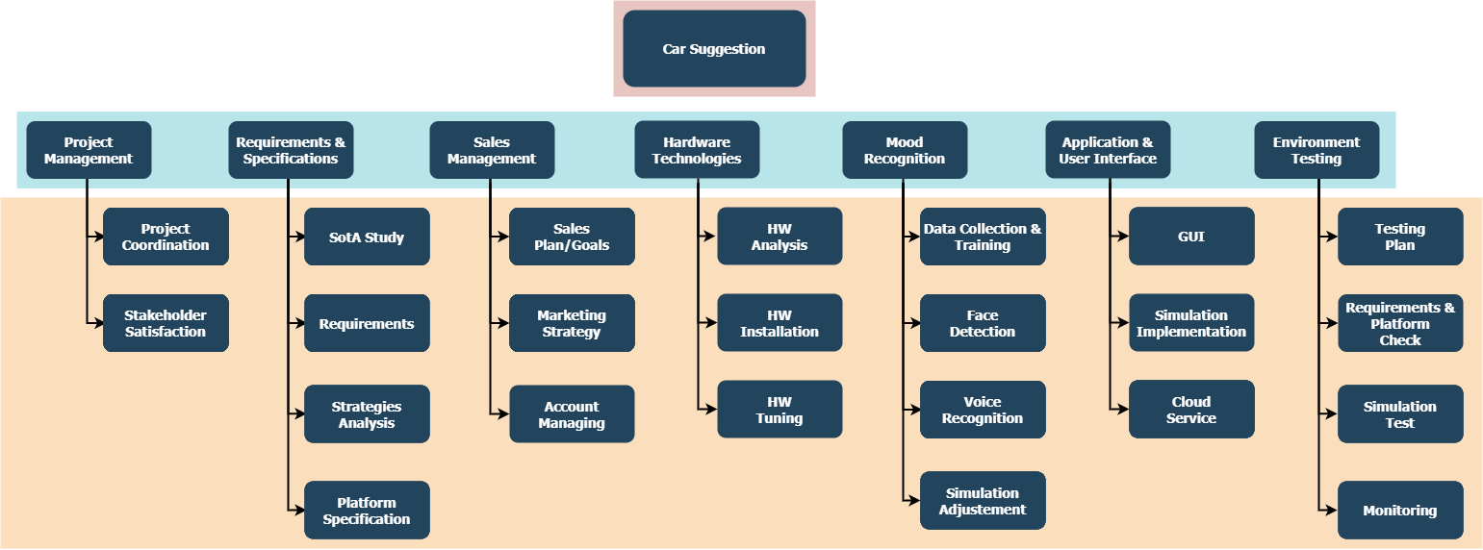
Work package
Notes:
https://www.projectpro.io/article/aws-vs-azure-who-is-the-big-winner-in-the-cloud-war/401
https://sam-solutions.us/aws-vs-azure-v-s-google-cloud-which-is-better/
https://jelvix.com/blog/aws-vs-google-cloud-vs-azure

Slide 58
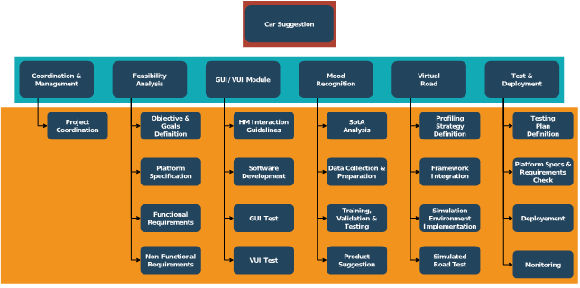
Work package
Notes:
https://www.projectpro.io/article/aws-vs-azure-who-is-the-big-winner-in-the-cloud-war/401
https://sam-solutions.us/aws-vs-azure-v-s-google-cloud-which-is-better/
https://jelvix.com/blog/aws-vs-google-cloud-vs-azure

Slide 59
Risk evaluation
RISK | PROBLEM | SOLUTION
Cloud | Performance and cost | Deep market analysis
Hardware | Better HW system at lower price | Reduce the HW dependent code
AI | Model obsolescence | Abstract the class implementation methods
Privacy | Personal profile management | Rely on external cybersecurity companies
Notes:
https://www.projectpro.io/article/aws-vs-azure-who-is-the-big-winner-in-the-cloud-war/401
https://sam-solutions.us/aws-vs-azure-v-s-google-cloud-which-is-better/
https://jelvix.com/blog/aws-vs-google-cloud-vs-azure

Slide 60
Risk evaluation
RISK | PROBLEM | SOLUTION
Cloud | License agreements, performance and costs | Deep market analysis to identify best technical support, SW updates and license agreements.
Hardware | Better HW system at lower price | Exploit programming languages not HW related.
Software | Better SW system at lower price | Exploit highly compatible and modulable SDK.
AI | More accurate models available | Abstract the implementation of the class methods to make the model independent from them.
Privacy | Management of personal data | Rely on external cybersecurity companies.
Notes:
https://www.projectpro.io/article/aws-vs-azure-who-is-the-big-winner-in-the-cloud-war/401
https://sam-solutions.us/aws-vs-azure-v-s-google-cloud-which-is-better/
https://jelvix.com/blog/aws-vs-google-cloud-vs-azure

